Slide 1

CSS
By Mitchell Froelich and Brendan Harrington
Transitions

Slide 2
CSS
By Mitchell Froelich and Brendan Harrington
Transitions

Slide 3
CSS
History
Created by Dean Jackson, David Hyatt, and Chris Marrin out of Apple Inc.
First released in the late 2000’s
Allowed CSS property changes to occur smoothly over a specified duration
Now referred to more as CSS animations after library expansion
By Mitchell Froelich and Brendan Harrington
Transitions

Slide 4
CSS
Uses
Used to create menus, enhance websites, and provide new avenues of creative freedom when designing your webpages
Allows for darkening on hovers, color changes, filters for images, and even object growth or shrinking
History
By Mitchell Froelich and Brendan Harrington
Transitions
Created by Dean Jackson, David Hyatt, and Chris Marrin out of Apple Inc.
First released in the late 2000’s
Allowed CSS property changes to occur smoothly over a specified duration
Now referred to more as CSS animations after library expansion

Slide 5
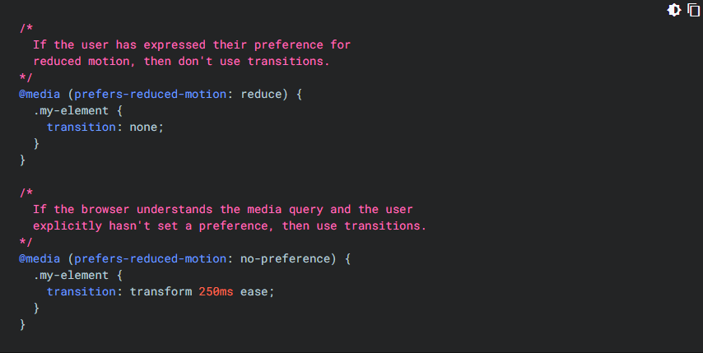
CSS
Considerations
Transitions are NOT for everyone; some people can get motion sick or general discomfort. Fortunately, CSS has a query option for detecting if the user has selected an option for less motion on their device.
History
Uses
By Mitchell Froelich and Brendan Harrington
Transitions
Used to create menus, enhance websites, and provide new avenues of creative freedom when designing your webpages
Allows for darkening on hovers, color changes, filters for images, and even object growth or shrinking

Slide 6
CSS
Considerations
Transitions are NOT for everyone; some people can get motion sick or general discomfort. Fortunately, CSS has a query option for detecting if the user has selected an option for less motion on their device.
History
Uses
By Mitchell Froelich and Brendan Harrington
Transitions
Used to create menus, enhance websites, and provide new avenues of creative freedom when designing your webpages
Allows for darkening on hovers, filters for images, color changes, and even object growth or shrinking

Slide 7
CSS
Demo Time!
Here is some examples of a couple cool things you can make with CSS and HTML (and just a pinch of JavaScript)
History
Uses
By Mitchell Froelich and Brendan Harrington
Transitions
Used to create menus, enhance websites, and provide new avenues of creative freedom when designing your webpages
Allows for darkening on hovers, filters for images, color changes, and even object growth or shrinking
Considerations
Transitions are NOT for everyone; some people can get motion sick or general discomfort. Fortunately, CSS has a query option for detecting if the user has selected an option for less motion on their device.

Slide 8
CSS
The End
References:
https://web.dev/learn/css/transitions
https://www.w3schools.com/css/css3_transitions.asp
https://freefrontend.com/css-page-transitions/
History
Uses
By Mitchell Froelich and Brendan Harrington
Transitions
Used to create menus, enhance websites, and provide new avenues of creative freedom when designing your webpages
Allows for darkening on hovers, filters for images, color changes, and even object growth or shrinking
Demo Time!
Considerations
Here is some examples of a couple cool things you can make with CSS and HTML (and just a pinch of JavaScript)
Transitions are NOT for everyone; some people can get motion sick or general discomfort. Fortunately, CSS has a query option for detecting if the user has selected an option for less motion on their device.

Slide 9
CSS
History
Uses
By Mitchell Froelich and Brendan Harrington
Transitions
The End
Used to create menus, enhance websites, and provide new avenues of creative freedom when designing your webpages
Allows for darkening on hovers, filters for images, color changes, and even object growth or shrinking
Demo Time!
Questions?
References:
https://web.dev/learn/css/transitions
https://www.w3schools.com/css/css3_transitions.asp
https://freefrontend.com/css-page-transitions/
Considerations
Here is some examples of a couple cool things you can make with CSS and HTML (and just a pinch of JavaScript)
Transitions are NOT for everyone; some people can get motion sick or general discomfort. Fortunately, CSS has a query option for detecting if the user has selected an option for less motion on their device.

Slide 10
CSS
Questions?
History
Uses
By Mitchell Froelich and Brendan Harrington

